Slide 1
Data Science Intensive Final Presentation
Eric Fuhrman

Slide 2
Background
94 participants in behavioral psychology study about the impact of emotional/neutral words in cognitive tasks
Took personality assessment tests as well as automated task series
Task results saved in E-Prime software, then exported to text file
Personality assessments coded into Excel

Slide 3
Data Capture & Cleaning
E-Prime text files parsed in Python to create Pandas data frame
Each task in text file as multiple lines of text, one for each data point
Total of 220 observations per participant
Two participants had no recordable responses and were eliminated
Stimulus words were classified as “Positive”, “Negative”, and “Neutral”
25 personality scores were captured for each participant
Some of those scores were sub-scores of others. For instance “TSWB_mean” had subscores “TSWB_distraction”, “TSWB_intrusive”, and “TSWB_oppression”.
Some scores were not captured for some participants, those observations were eliminated from models where necessary.

Slide 4
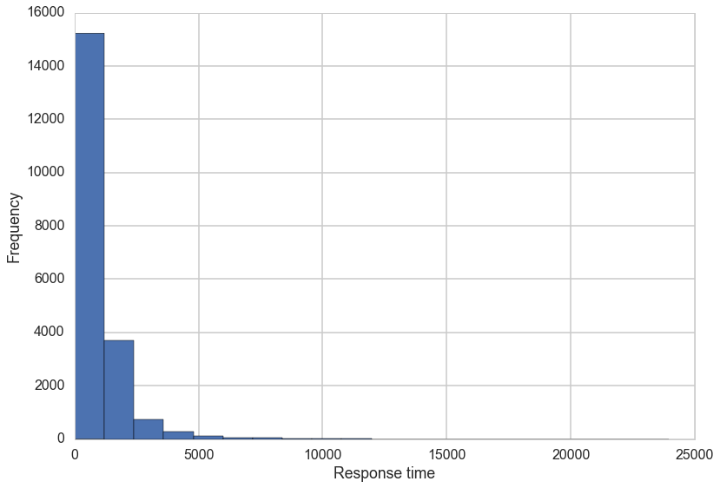
Response Time
Response time variable of interest, but was left-skewed:

Slide 5
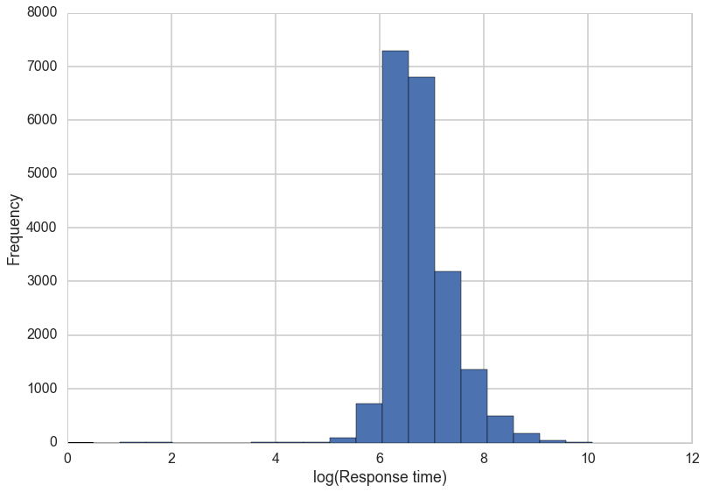
Response time
Response time log-transformed for better analysis

Slide 6
Predictor Personality Variables
Scatterplot matrices and histograms were prepared for “parent” personality measures
All scores show acceptable normality
No evidence of collinearity to worry about
Scatterplot matrices also prepared for score groups
Values show acceptable normality
Variables are very highly correlated, will need to avoid using members of the same group in model

Slide 7
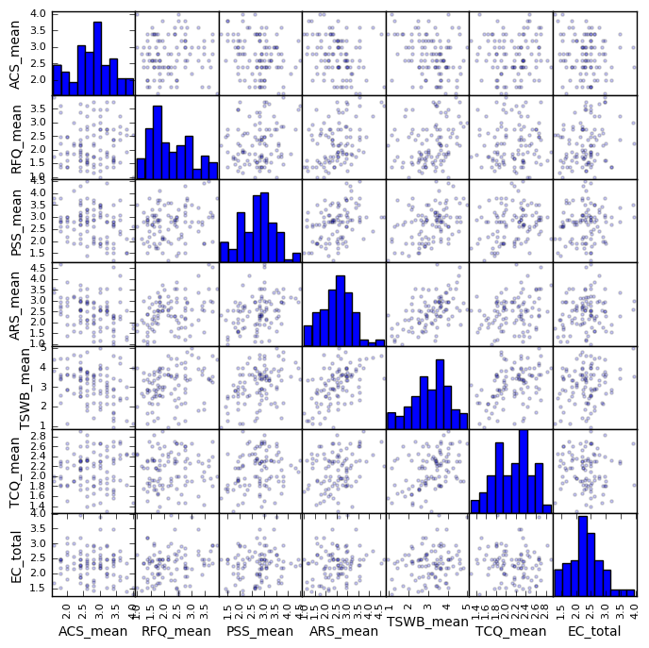
Personality scores

Slide 8
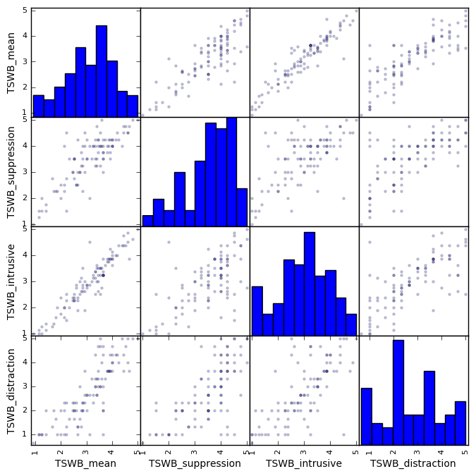
Personality scores

Slide 9
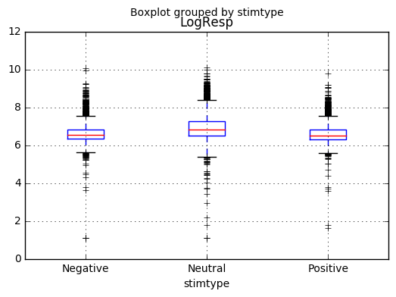
Review Range of Log-Response Times

Slide 10
Observations about Response Times
Surprising result in that tasks with Neutral stimuli have longer and more variable response times
Sections of tasks have different content of Positive/Negative/Neutral, but this doesn’t seem to impact length and variability of Neutral tasks

Slide 11
Analysis
Ordinary Least Squares regression run initially to determine impact of stimulus type and different subjects
Effect of Neutral stimulus above Negative baseline in OLS regression was 0.244 with a t-value > 30.
Significant variability between subjects noted, so additional modeling was in order to estimate if subject variability was correlated with personality variables.

Slide 12
Analysis
Since observations within a subject are not independent, a mixed linear model was prepared to account for the group effect of subject.
All variables were analyzed, and statistically insignificant variables were dropped from successive iterations of the model
Model included both the effect of the personality measure as well as an interaction term with the stimulus type

Slide 13
Final Model
Feature | Coef | Std Error | Z-value | P-value | 95% Confidence interval
Intercept | 6.943 | 0.215 | 32.288 | 0.000 | 6.522 | 7.365
stimtype[T.Neutral] | 0.164 | 0.042 | 3.915 | 0.000 | 0.082 | 0.246
stimtype[T.Positive] | 0.011 | 0.050 | 0.215 | 0.830 | -0.087 | 0.108
PSS_mean | -0.086 | 0.043 | -2.000 | 0.045 | -0.170 | -0.002
stimtype[T.Neutral]:PSS_mean | 0.046 | 0.015 | 3.101 | 0.002 | 0.017 | 0.075
stimtype[T.Positive]:PSS_mean | -0.013 | 0.018 | -0.753 | 0.451 | -0.048 | 0.021
RFQ_mean | 0.122 | 0.036 | 3.425 | 0.001 | 0.052 | 0.192
ACS_mean | -0.128 | 0.049 | -2.604 | 0.009 | -0.225 | -0.032
Intercept RE | 0.054 | 0.017

Slide 14
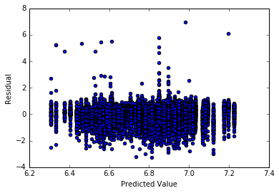
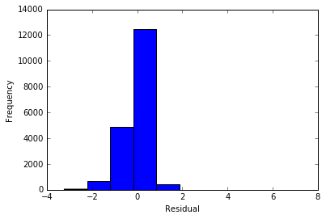
Predicted values vs. Residuals and Histogram of Residuals

Slide 15
Conclusions
Tested personality traits have a statistically significant effect on response times in these tasks
RFQ_mean score and ACS_mean score are correlated to overall response times
PSS_mean score interacting with stimulus type showed a longer response time specifically on Neutral tasks
These factors combined with further research could lead to increased understanding of the emotional and cognitive processes involved with performing these and other tasks

